Slide 1
AWS Elastic Compute Cloud (EC2)
EC2 uses XEN (open-source hypervisor) for creating VM
Amazon EC2 provides scalable computing capacity in the AWS cloud.
You can use EC2 to launch as many or as few instances as you need, configure security and networking, and manage storage.
EC2 enable you to scale up and scale down instances.
Pre-configured templates of EC2 instances are available which are known as Amazon Machine Image.

Slide 2
AWS EC2 Instance Types
General Purpose: Balanced Memory & CPU
Compute Optimized: More CPU than RAM
Memory Optimized: More RAM
Storage Optimized: Low latency
High Memory: High RAM on Nitro system
Accelerated Computing/GPU: Graphics optimized

Slide 3
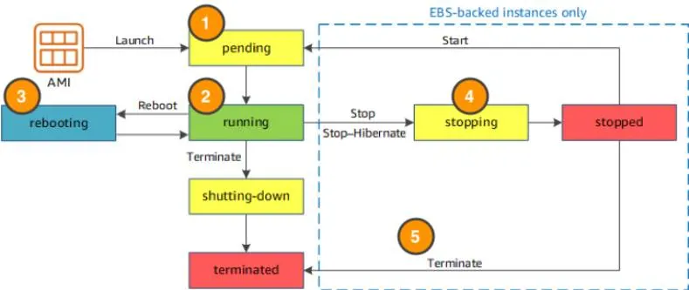
AWS EC2 Instance Life Cycle

Slide 4
AWS EC2 Instance Life Cycle
When you launch an instance, it enters the pending state (1). When the instance is pending, billing has not started. At this stage, the instance is preparing to enter the running state.

Slide 5
AWS EC2 Instance Life Cycle
When your instance is running (2), it's ready to use. This is also the stage where billing begins. As soon as an instance is running, you are then able to take other actions on the instance, such as reboot, terminate, stop, and stop-hibernate.

Slide 6
AWS EC2 Instance Life Cycle
When you reboot an instance (3), it’s different than performing a stop action and then a start action. Rebooting an instance is equivalent to rebooting an operating system. The instance remains on the same host computer and maintains its public and private IP address, and any data on its instance store.
Private IP address of a system is the IP address that is used to communicate within the same network. Using private IP data or information can be sent or received within the same network. Public IP address of a system is the IP address that is used to communicate outside the network.

Slide 7
AWS EC2 Instance Life Cycle
When you stop and start an instance (4), your instance may be placed on a new underlying physical server. Therefore, you lose any data on the instance store that were on the previous host computer. When you stop an instance, the instance gets a new public IP address but maintains the same private IP address.

Slide 8
AWS EC2 Instance Life Cycle
When you terminate an instance (5), the instance store are erased, and you lose both the public IP address and private IP address of the machine. Termination of an instance means you can no longer access the machine.

Slide 9
AWS EC2 Instance Life Cycle
When you launch an instance, it enters the pending state (1). When the instance is pending, billing has not started. At this stage, the instance is preparing to enter the running state.
When your instance is running (2), it's ready to use. This is also the stage where billing begins. As soon as an instance is running, you are then able to take other actions on the instance, such as reboot, terminate, stop, and stop-hibernate.
When you reboot an instance (3), it’s different than performing a stop action and then a start action. Rebooting an instance is equivalent to rebooting an operating system. The instance remains on the same host computer and maintains its public and private IP address (Private IP address of a system is the IP address that is used to communicate within the same network. Using private IP data or information can be sent or received within the same network. Public IP address of a system is the IP address that is used to communicate outside the network.), and any data on its instance store.
It typically takes a few minutes for the reboot to complete. When you stop and start an instance (4), your instance may be placed on a new underlying physical server. Therefore, you lose any data on the instance store that were on the previous host computer. When you stop an instance, the instance gets a new public IP address but maintains the same private IP address.
When you terminate an instance (5), the instance store are erased, and you lose both the public IP address and private IP address of the machine. Termination of an instance means you can no longer access the machine.

Slide 10
AWS EC2 Storage Options
Two types of block store devices are available for EC2 instances:
Elastic Block Storage
Instance Storage

